Slide 1
Sea Level Rise Results
Cory Alini

Slide 2
Relevant Work
NOAA Coastal Services Center.” Detailed Methodology for Mapping Sea Level Rise Inundation.”
Li, Xingong, C. J. Grady, and A. Townsend Peterson. ”Delineating Sea Level Rise Inundation Using a Graph Traversal Algorithm.”

Slide 3
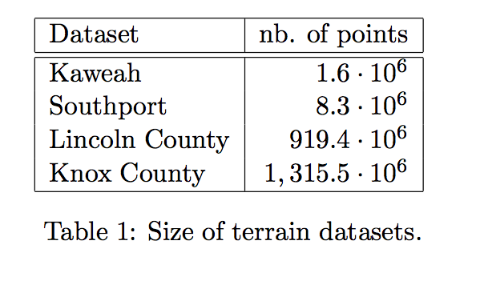
Size

Slide 4
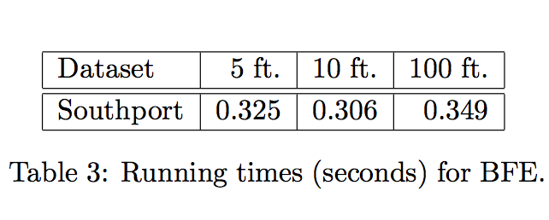
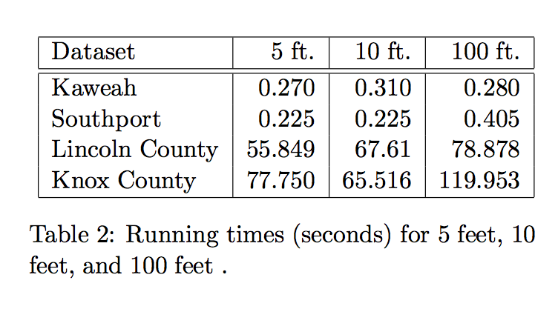
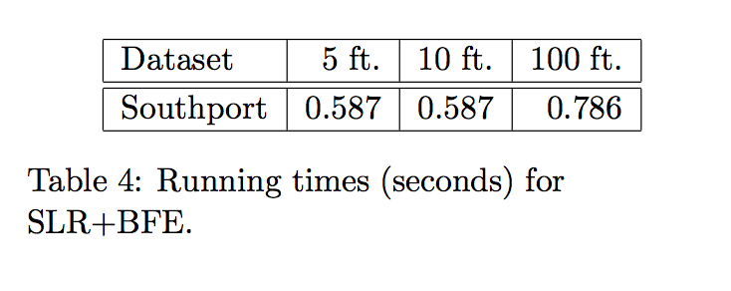
Run times

Slide 5
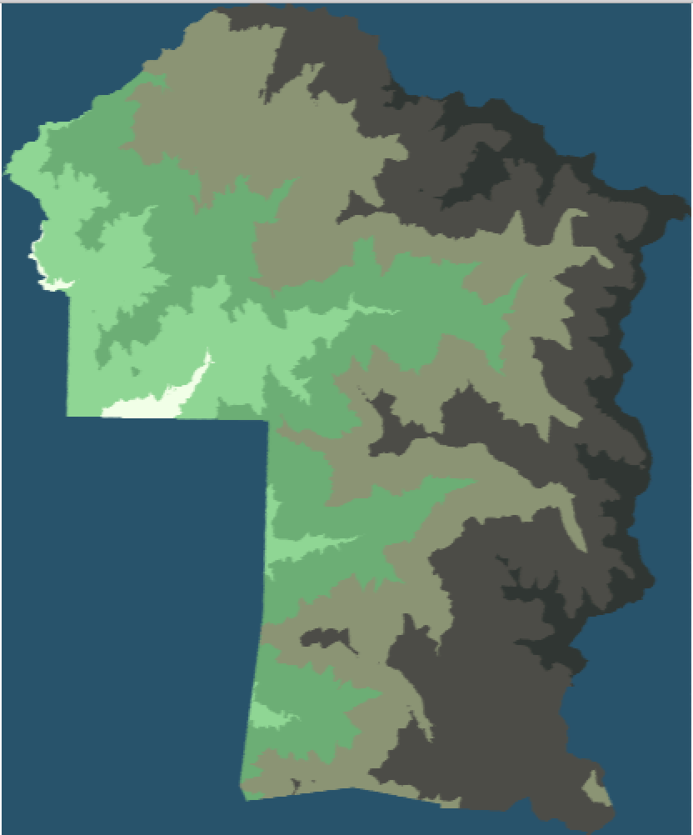
Original Kaweah

Slide 6
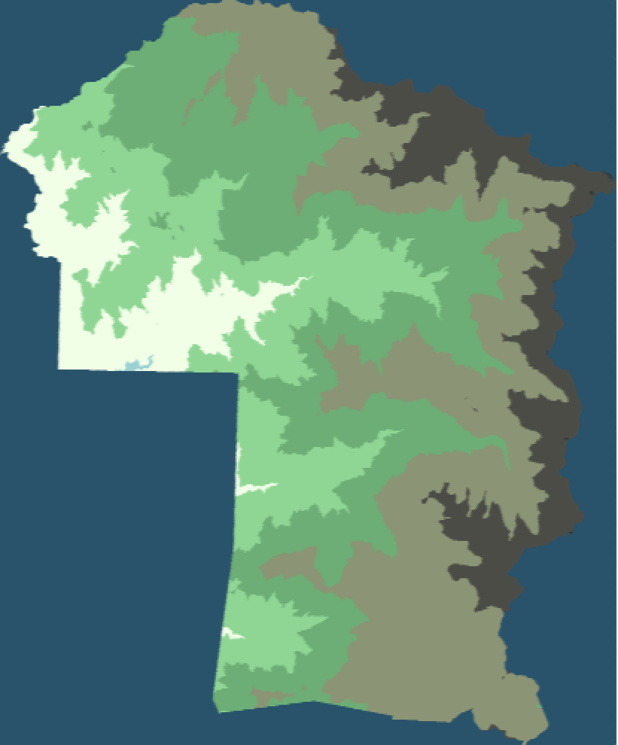
Kaweah 500

Slide 7
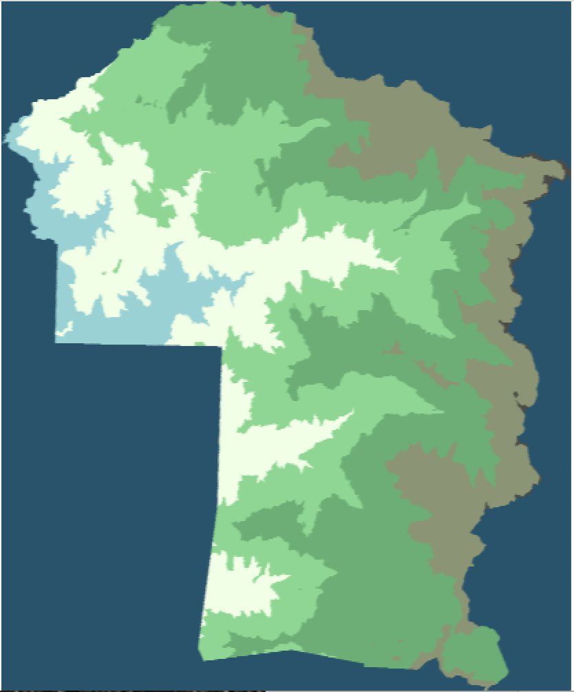
Kaweah 1000

Slide 8
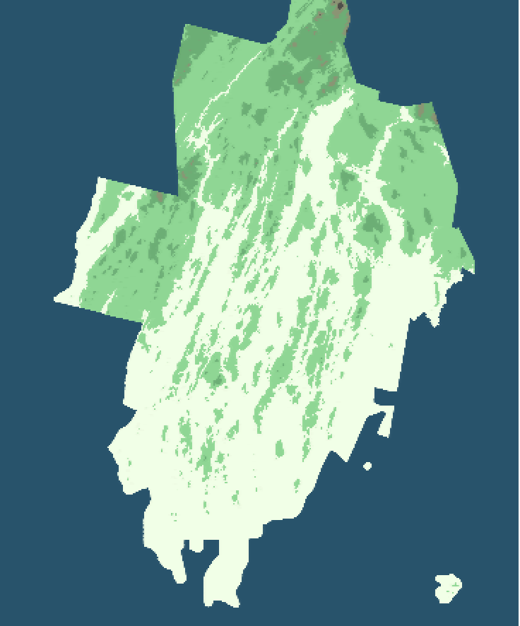
Original Lincoln

Slide 9
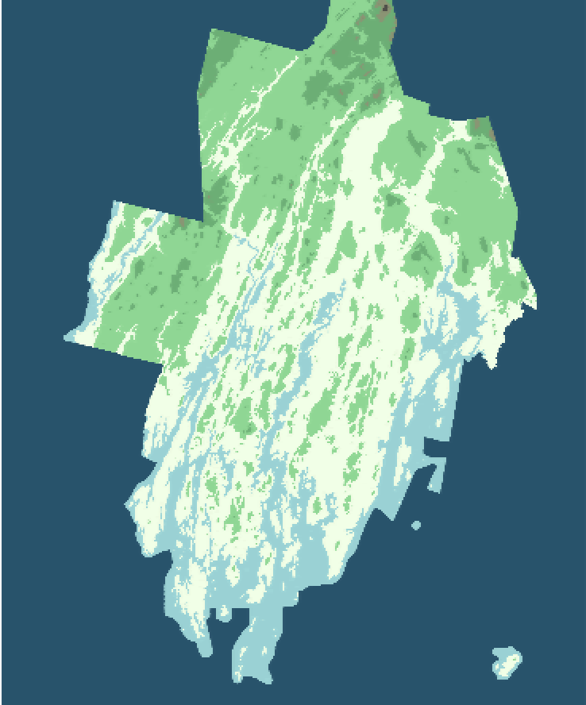
Lincoln 5

Slide 10
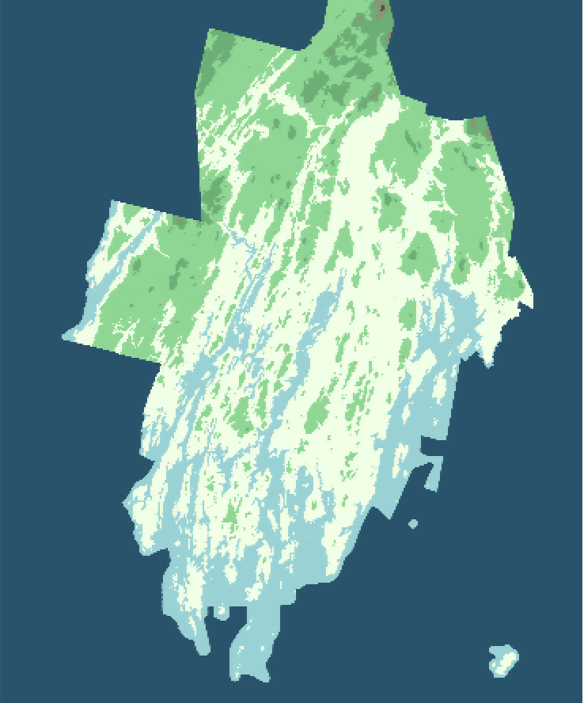
Lincoln 10

Slide 11
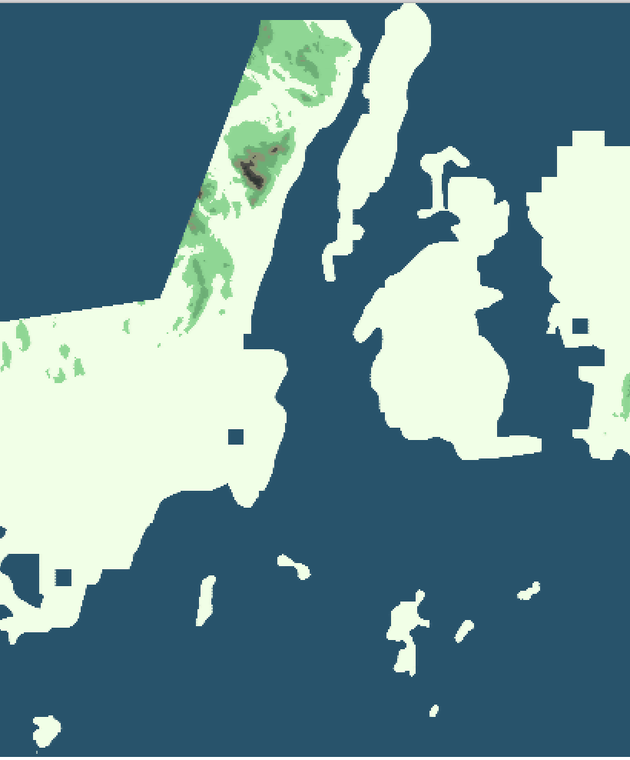
Original Knox

Slide 12
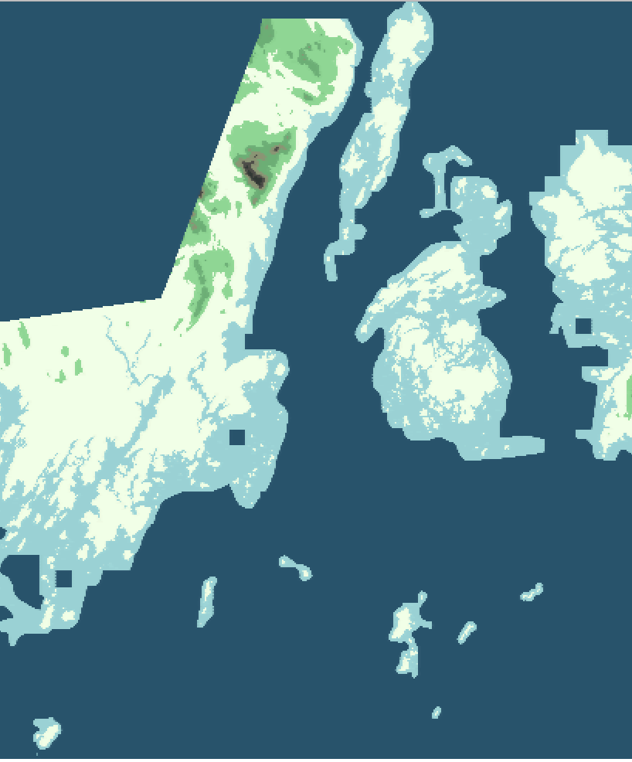
Knox 5

Slide 13

Knox 10

